Slide 1
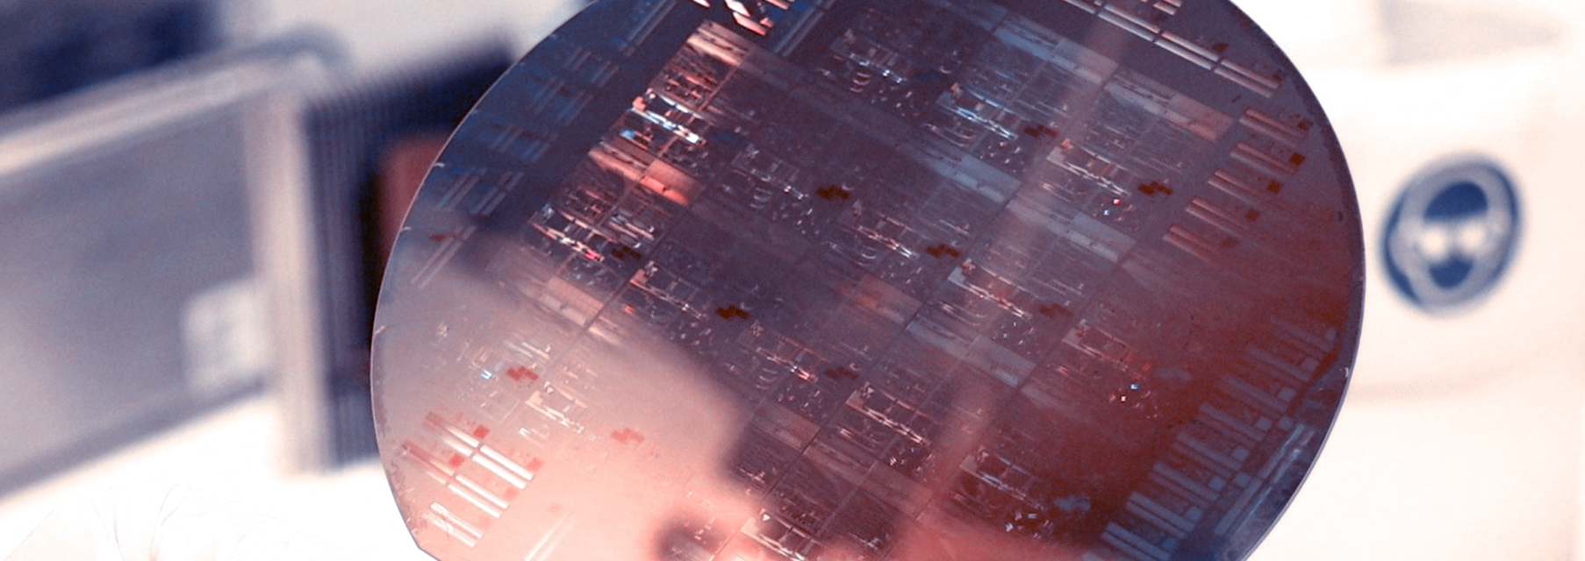
Programmable Integrated Photonics
Topic 6: WDM Cascaded MZIs
Notes:
v

Slide 2
Table of contents
What is WDM?
Examples of commercial WDMs
Implementation of a WDM
WDM Network Architecture and Naming Conventions
WDM Building blocks
From Single MZI Response to Target Spectral Distribution
Transfer Function
Spectral Window Formation via Phase Shifting
Layout
Conclusions

Slide 3
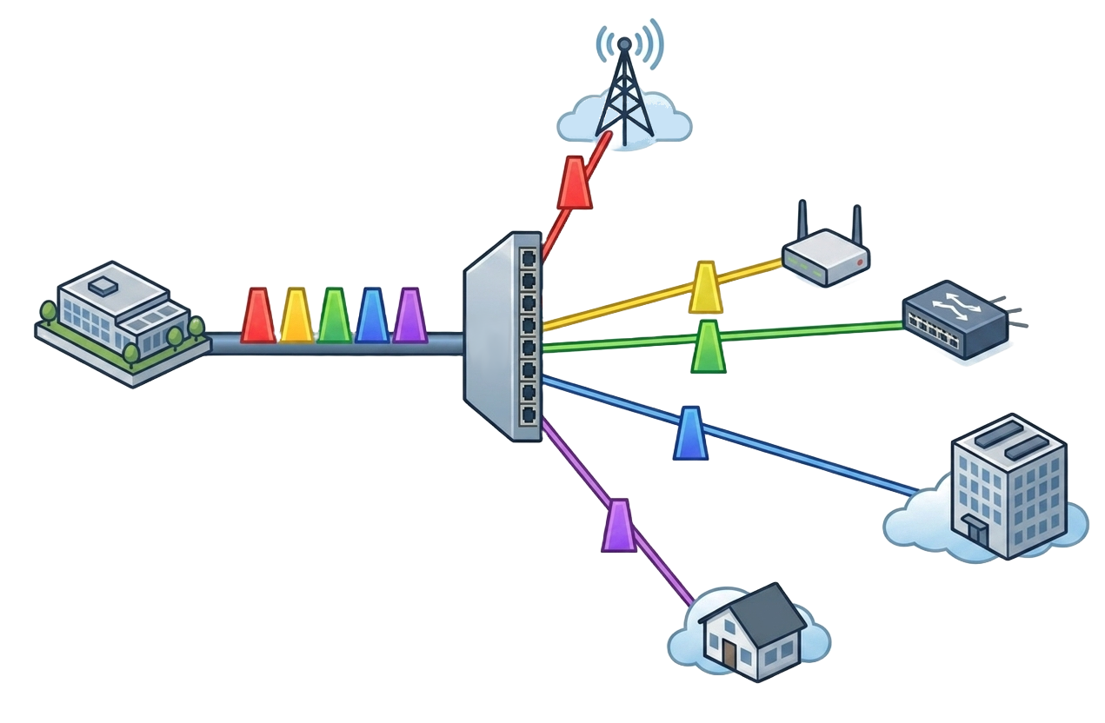
What is WDM?
Wavelength Division Multiplexing (WDM) is a transmission technique used on optical fibers that uses multiple wavelengths to send data through the same medium, two or more “colors” can travel on a single fiber transmitting multiple signals under different wavelengths or frequencies in the optical spectrum. By enabling multiple optical channels to be transmitted over a single waveguide, WDM significantly enhances link capacity without increasing footprint or fiber count.
When implemented on silicon photonics platforms, WDM systems benefit from reduced power consumption and lower assembly costs, due to their compatibility with CMOS fabrication and high level of integration.
How do we catch a color?
Notes:
En esta diapositive queremos hablar de las convenciones utilizadas, por ejemplo los nombres de los MZI y que nuestra entrada es el puerto inferior, ademas queremos hablar de la function de cada uno de los mismos por ejemplo que la etapa uno es la que define los canales, la etapa dos es la que divide en sub grupos los canales y la etapa 3 es el filtro mas refinado que permite obtener cada una de las salidas.
The shape of the transmission passband in the 1st filter plays a decisive role in the final shapes at the 8 outputs

Slide 4
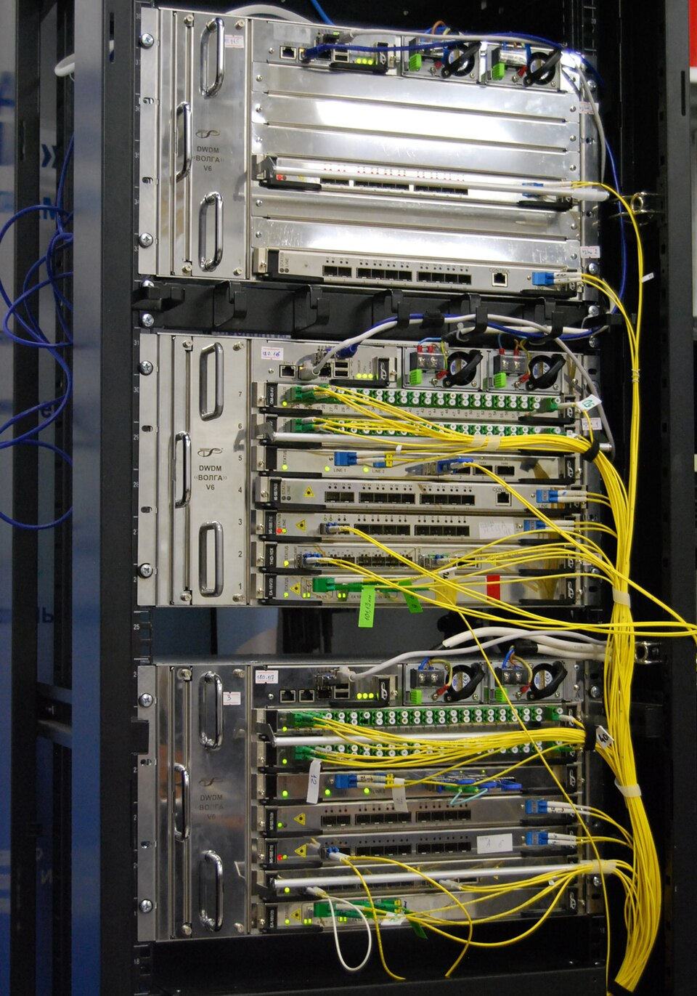
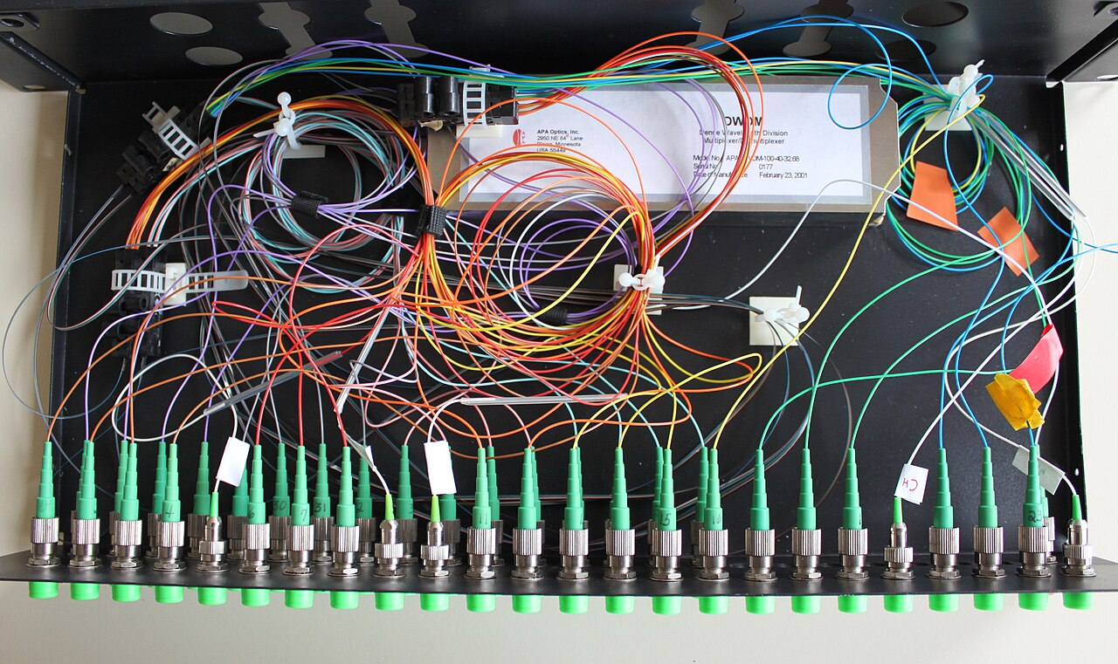
Examples of commercial WDMs
Finot, C. (2015). WDM multiplexer for DWDM communications [Image]. Licensed under CC BY-SA 3.0.
dwdmstop all, S. (2020). WDM/DWDM System in rack 19/21" [Image]. Licensed under CC BY-SA 4.0.

Slide 5
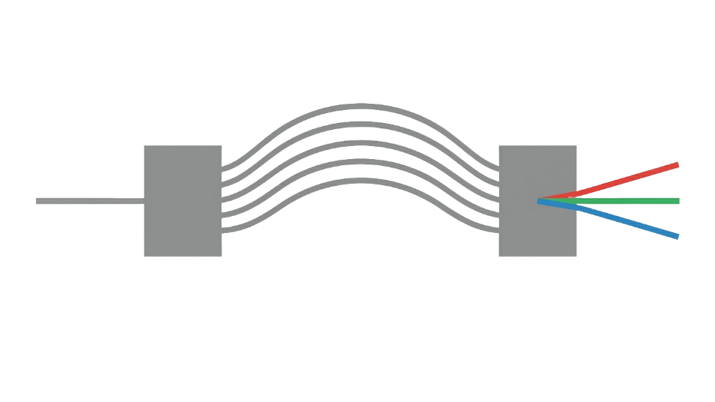


Implementation of a WDM
Arrayed waveguide gratings
Not so easy to design
Moderate loses
Micro-ring resonators
Lack of flexibility
Small tolerance to fabrication errors
Multistage Bragg Gratings
Small tolerance to fabrication errors
T. -H. Yen and Y. -J. Hung, "Fabrication-Tolerant CWDM (de)Multiplexer Based on Cascaded Mach–Zehnder Interferometers on Silicon-on-Insulator," in Journal of Lightwave Technology, vol. 39, no. 1, pp. 146-153, 1 Jan.1, 2021, doi: 10.1109/JLT.2020.3026314.
Notes:
En esta diapositive queremos hablar de las convenciones utilizadas, por ejemplo los nombres de los MZI y que nuestra entrada es el puerto inferior, ademas queremos hablar de la function de cada uno de los mismos por ejemplo que la etapa uno es la que define los canales, la etapa dos es la que divide en sub grupos los canales y la etapa 3 es el filtro mas refinado que permite obtener cada una de las salidas.
The shape of the transmission passband in the 1st filter plays a decisive role in the final shapes at the 8 outputs

Slide 6
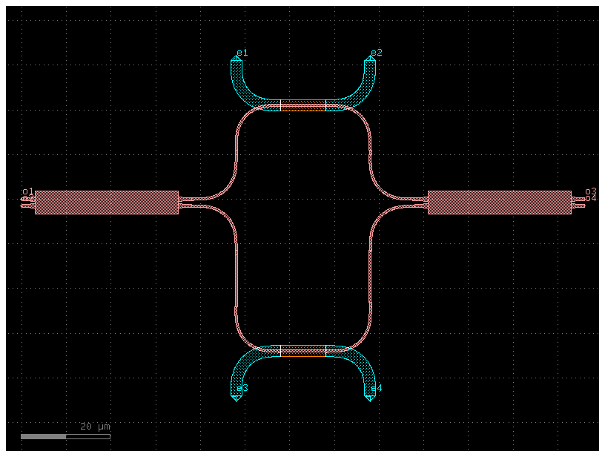
Implementation of a WDM
MZI
Cascaded Mach-Zehnder interferometers (MZI) have been widely applied to build WDM demultiplexers due to its low insertion loss, and the control they offer over channel spacing and spectral response.
Although these devices are inherently sensitive to fabrication variations and thermal fluctuations, their performance can be effectively stabilized through post-fabrication tuning and proper encapsulation. In particular, thermo-optic phase shifters allow compensation of phase errors.
T. -H. Yen and Y. -J. Hung, "Fabrication-Tolerant CWDM (de)Multiplexer Based on Cascaded Mach–Zehnder Interferometers on Silicon-on-Insulator," in Journal of Lightwave Technology, vol. 39, no. 1, pp. 146-153, 1 Jan.1, 2021, doi: 10.1109/JLT.2020.3026314.
Qiyuan Yi, Shuang Zheng, Zhiwei Yan, Guanglian Cheng, Fanglu Xu, Qiyuan Li, and Li Shen, "Silicon photonic flat-top WDM (de)multiplexer based on cascaded Mach-Zehnder interferometers for the 2 µm wavelength band," Opt. Express 30, 28232-28241 (2022)
Notes:
En esta diapositive queremos hablar de las convenciones utilizadas, por ejemplo los nombres de los MZI y que nuestra entrada es el puerto inferior, ademas queremos hablar de la function de cada uno de los mismos por ejemplo que la etapa uno es la que define los canales, la etapa dos es la que divide en sub grupos los canales y la etapa 3 es el filtro mas refinado que permite obtener cada una de las salidas.
The shape of the transmission passband in the 1st filter plays a decisive role in the final shapes at the 8 outputs

Slide 7
WDM Network Architecture and Naming Conventions
This diagram introduces the naming convention of each MZI stage and the signal flow. The input is defined at the lower port.
Stage 1
Stage 2
Stage 3
The shape of the outputs in the 1st MZI plays a decisive role in the final shapes of the 8 outputs
Splits channels into subgroups
Refines the filtering to obtain individual outputs
Out 8
MZI_4_8
Out 4
Cross
MZI_TP
Bar
Out 6
Cross
MZI_2_6
Out 2
Input
MZI_In
Bar
Out 7
MZI_3_7
Out 3
Cross
MZI_BM
Bar
Out 5
MZI_1_5
Out 1
Notes:
En esta diapositive queremos hablar de las convenciones utilizadas, por ejemplo los nombres de los MZI y que nuestra entrada es el puerto inferior, ademas queremos hablar de la function de cada uno de los mismos por ejemplo que la etapa uno es la que define los canales, la etapa dos es la que divide en sub grupos los canales y la etapa 3 es el filtro mas refinado que permite obtener cada una de las salidas.
The shape of the outputs in the 1st MZI plays a decisive role in the final shapes of the 8 outputs

Slide 8
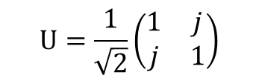


WDM Building blocks
An MMI acts as a passive linear transformation block that performs power splitting-combining and phase mixing between input signals, through multimode interference, according to a fixed unitary transfer matrix defined by its geometry.
$$\begin{matrix}U=\frac{1}{\sqrt{2}}\left(\begin{matrix}1 & j \\ j & 1\end{matrix}\right)\end{matrix}$$
Produce well-defined amplitude splitting ratios (50:50) and fixed relative phase relationships between outputs (π/2), ideally.
A phase shifter acts as a passive phase control element that introduces a controlled optical phase delay between propagating signals, determined by the optical path length.
$$\begin{matrix}Delay\left(βL\right)=\left(\begin{matrix}e^{−jβL} & 0 \\ 0 & 1\end{matrix}\right)\end{matrix}$$
This phase shift is typically achieved by creating a path length difference between two arms, resulting in a relative phase offset $\begin{matrix}Δφ=βΔL\end{matrix}$ , where $β$ is the propagation constant.
$$\begin{matrix}Phase\left(φ\right)=\left(\begin{matrix}e^{jφ} & 0 \\ 0 & 1\end{matrix}\right)\end{matrix}$$
While the phase can be statically defined by geometry, it can also be dynamically tuned through changes in the effective refractive index for example via thermo-optic effects, enabling reconfigurable operation.
Notes:
Que operaciones conocemos
The shape of the transmission passband in the 1st filter plays a decisive role in the final shapes at the 8 outputs

Slide 9


WDM Building blocks
$$∆L$$
MMI
PS
MMI
MZI
$With P=e^{jφ} y D=$ $e^{−jβL }$:
$$\begin{matrix}H=U⋅Phase⋅Delay⋅U=\frac{1}{2}\left(\begin{matrix}−1+e^{jφ}e^{−jβL} & j\left(1+e^{jφ}e^{−jβL}\right) \\ j\left(1+e^{jφ}e^{−jβL}\right) & 1−e^{jφ}e^{−jβL}\end{matrix}\right)=\frac{1}{2}\left(\begin{matrix}PD−1 & j\left(1+PD\right) \\ j\left(1+PD\right) & 1−PD\end{matrix}\right)\end{matrix}$$
Notes:
Que operaciones conocemos
The shape of the transmission passband in the 1st filter plays a decisive role in the final shapes at the 8 outputs

Slide 10
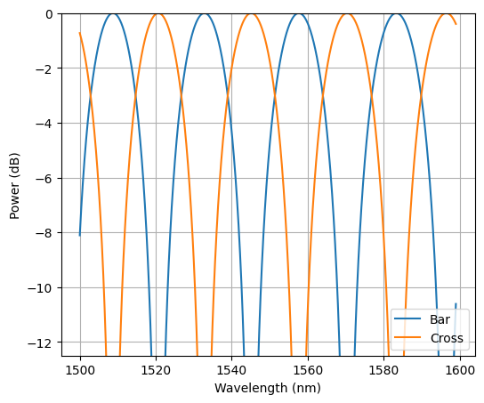
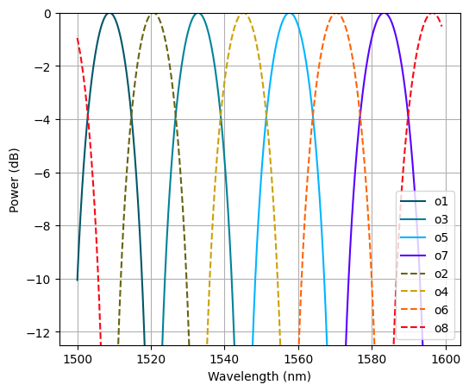
From Single MZI Response to Target Spectral Distribution
The output of the first MZI determines the initial spectral shaping.
This response is progressively transformed through subsequent stages to match the target multi-channel output.
1
2
3
4
5
6
7
8
Notes:
En esta diapositive se busca demostrar la salida del primer MZI y la salida objetivo que se busca al pasar las salidas por cada una de las etapas

Slide 11
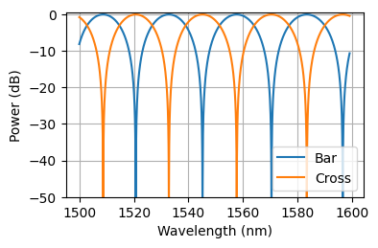
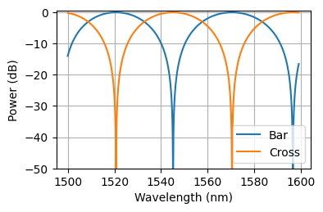
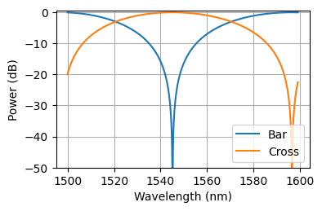





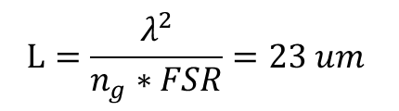

Spectral Evolution Across MZI Stages
Cross
MZI_4_8
$$∆L=L$$
MZI_TP
$$FSR=25 nm$$
Bar
Cross
MZI_2_6
$∆L=L/$4
$$∆L=L/2$$
MZI_In
Bar
$$FSR=50 nm$$
$$FSR=100 nm$$
MZI_3_7
Cross
$$L=\frac{λ^{2}}{n_{g}∗FSR}=23 um$$
MZI_BM
Bar
MZI_1_5
Notes:
Se presenta el espectro que tiene cada etapa de los MZI

Slide 12

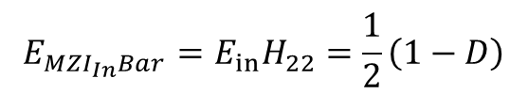
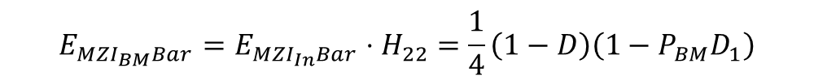

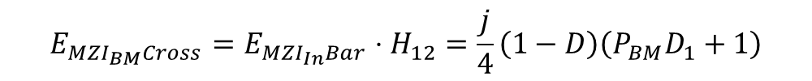


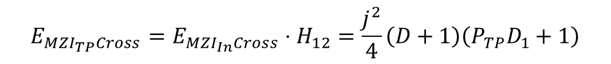

Transfer Function
Stage 1
$$\begin{matrix}E_{MZI_{In}Cross}={E_{in}H}_{12}=\frac{j}{2}\left(D+1\right)\end{matrix}$$
Cross
Input
MZI_In
Bar
$$\begin{matrix}E_{MZI_{In}Bar}=E_{in}H_{22}=\frac{1}{2}\left(1−D\right)\end{matrix}$$
Stage 2
$$\begin{matrix}E_{MZI_{TP}Cross}=E_{MZI_{In}Cross}⋅H_{12}=\frac{j^{2}}{4}\left(D+1\right)\left(P_{TP}D_{1}+1\right)\end{matrix}$$
Cross
$$E_{MZI_{In}Cross}$$
MZI_TP
Bar
$$\begin{matrix}E_{MZI_{TP}Bar}=E_{MZI_{In}Cross}⋅H_{22}=\frac{j}{4}\left(D+1\right)\left(1−P_{TP}D_{1}\right)\end{matrix}$$
$$∆L=L/2$$
$$FSR=50 nm$$
$$\begin{matrix}E_{MZI_{BM}Cross}=E_{MZI_{In}Bar}⋅H_{12}=\frac{j}{4}\left(1−D\right)\left(P_{BM}D_{1}+1\right)\end{matrix}$$
Cross
$$E_{MZI_{In}Bar}$$
MZI_BM
Bar
$$\begin{matrix}E_{MZI_{BM}Bar}=E_{MZI_{In}Bar}⋅H_{22}=\frac{1}{4}\left(1−D\right)\left(1−P_{BM}D_{1}\right)\end{matrix}$$

Slide 13
Transfer Function
Due to the complementary nature of the bar and cross ports, selecting a transmission window at one output automatically results in the corresponding complementary response at the other port.
Stage 2
$$\begin{matrix}E_{MZI_{TP}Cross}=E_{MZI_{In}Cross}⋅H_{12}=\frac{j^{2}}{4}\left(D+1\right)\left(P_{TP}D_{1}+1\right)\end{matrix}$$
Cross
$$E_{MZI_{In}Cross}$$
MZI_TP
Bar
$$\begin{matrix}E_{MZI_{TP}Bar}=E_{MZI_{In}Cross}⋅H_{22}=\frac{j}{4}\left(D+1\right)\left(1−P_{TP}D_{1}\right)\end{matrix}$$
$$∆L=L/2$$
$$FSR=50 nm$$
$$\begin{matrix}E_{MZI_{BM}Cross}=E_{MZI_{In}Bar}⋅H_{12}=\frac{j}{4}\left(1−D\right)\left(P_{BM}D_{1}+1\right)\end{matrix}$$
Cross
$$E_{MZI_{In}Bar}$$
MZI_BM
Bar
$$\begin{matrix}E_{MZI_{BM}Bar}=E_{MZI_{In}Bar}⋅H_{22}=\frac{1}{4}\left(1−D\right)\left(1−P_{BM}D_{1}\right)\end{matrix}$$

Slide 14




Transfer Function
Stage 3
$$\begin{matrix}E_{out_{8}Cross}=E_{MZI_{TP}Cross}⋅H_{12}=\frac{j^{3}}{8}\left(D+1\right)\left(P_{TP}D_{1}+1\right)\left(P_{4∧8}D_{2}+1\right)\end{matrix}$$
Out 8
$$E_{MZI_{TP}Cross}$$
MZI_4_8
$$\begin{matrix}E_{out_{4}Bar}=E_{MZI_{TP}Cross}⋅H_{22}=\frac{j^{2}}{8}\left(D+1\right)\left(P_{TP}D_{1}+1\right)\left(1−P_{4∧8}D_{2}\right)\end{matrix}$$
Out 4
$$\begin{matrix}E_{out_{6}Cross}=E_{MZI_{TP}Bar}⋅H_{12}=\frac{j^{2}}{8}\left(D+1\right)\left(1−P_{TP}D_{1}\right)\left(P_{2∧6}D_{2}+1\right)\end{matrix}$$
Out 6
$$E_{MZI_{TP}Bar}$$
MZI_2_6
Out 2
$$\begin{matrix}E_{out_{2}Bar}=E_{MZI_{TP}Bar}⋅H_{22}=\frac{j}{8}\left(D+1\right)\left(1−P_{TP}D_{1}\right)\left(1−P_{2∧6}D_{2}\right)\end{matrix}$$
$$\begin{matrix}E_{out_{7}Cross}=E_{MZI_{BM}Cross}⋅H_{12}=\frac{j^{2}}{8}\left(1−D\right)\left(P_{BM}D_{1}+1\right)\left(P_{3∧7}D_{2}+1\right)\end{matrix}$$
Out 7
$$E_{MZI_{BM}Cross}$$
MZI_3_7
Out 3
$$\begin{matrix}E_{out_{3}Bar}=E_{MZI_{BM}Cross}⋅H_{22}=\frac{j}{8}\left(1−D\right)\left(P_{BM}D_{1}+1\right)\left(1−P_{3∧7}D_{2}\right)\end{matrix}$$
$$\begin{matrix}E_{out_{5}Cross}=E_{MZI_{BM}Bar}⋅H_{12}=\frac{j}{8}\left(1−D\right)\left(1−P_{BM}D_{1}\right)\left(P_{1∧5}D_{2}+1\right)\end{matrix}$$
Out 5
$$E_{MZI_{BM}Bar}$$
MZI_1_5
Out 1
$$\begin{matrix}E_{out_{1}Bar}=E_{MZI_{BM}Bar}⋅H_{22}=\frac{1}{8}\left(1−D\right)\left(1−P_{BM}D_{1}\right)\left(1−P_{1∧5}D_{2}\right)\end{matrix}$$

Slide 15
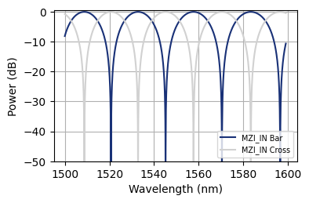
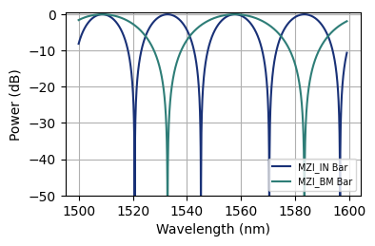
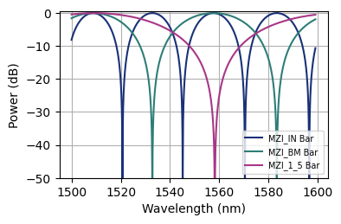

Spectral Window Formation via Phase Shifting
Cross
MZI_4_8
MZI_TP
Bar
Cross
MZI_2_6
In
MZI_In
Bar
MZI_3_7
Cross
MZI_BM
Bar
MZI_1_5
Out 1
Notes:
Se muestra el proceso de construccion de cada una de las ventanas desplazando la function de transferencia de los MZI
The thermal phase shifter is used to adjust the desired spectral window.
Due to the complementary nature of the bar and cross ports, selecting a transmission window at one output automatically results in the corresponding complementary response at the other port.

Slide 16
Spectral Window Formation via Phase Shifting
The thermal phase shifter is used to adjust the desired spectral window.
Due to the complementary nature of the bar and cross ports, selecting a transmission window at one output automatically results in the corresponding complementary response at the other port.
Cross
MZI_4_8
MZI_TP
Bar
Cross
MZI_2_6
In
MZI_In
Bar
MZI_3_7
Cross
MZI_BM
Bar
MZI_1_5
Out 1
Notes:
Se muestra el proceso de construccion de cada una de las ventanas desplazando la function de transferencia de los MZI
The thermal phase shifter is used to adjust the desired spectral window.
Due to the complementary nature of the bar and cross ports, selecting a transmission window at one output automatically results in the corresponding complementary response at the other port.

Slide 17
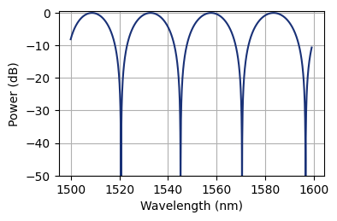
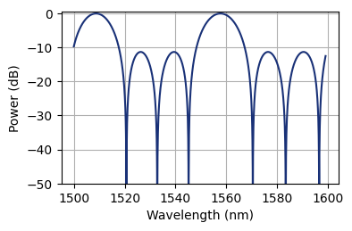
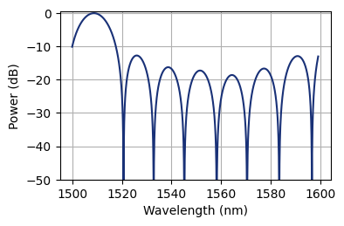
Spectral Window Formation via Phase Shifting
Cross
MZI_4_8
MZI_TP
Bar
Cross
MZI_2_6
In
MZI_In
Bar
MZI_3_7
Cross
MZI_BM
Bar
MZI_1_5
Out 1

Slide 18
Phase Shift Adjustments
Phase Shifter | Phase (rad) | Phase (°) | Δλ / FSR | FSR (nm) | Δλ (nm)
PS_BM | π/2 | 90° | 0.25 | 50 | 12.5
PS_TP | 0 | 0° | 0 | 50 | 0
PS_1_5 | 1.75π | 315° | 0.875 | 100 | 87.5
PS_3_7 | 1.25π | 225° | 0.625 | 100 | 62.5
PS_2_6 | 1.5π | 270° | 0.75 | 100 | 75
PS_4_8 | π | 180° | 0.5 | 100 | 50
Notes:
Aqui se presenta una table con las fases usadas y el desplazamiento en nm que genera en cada uno de los picos

Slide 19
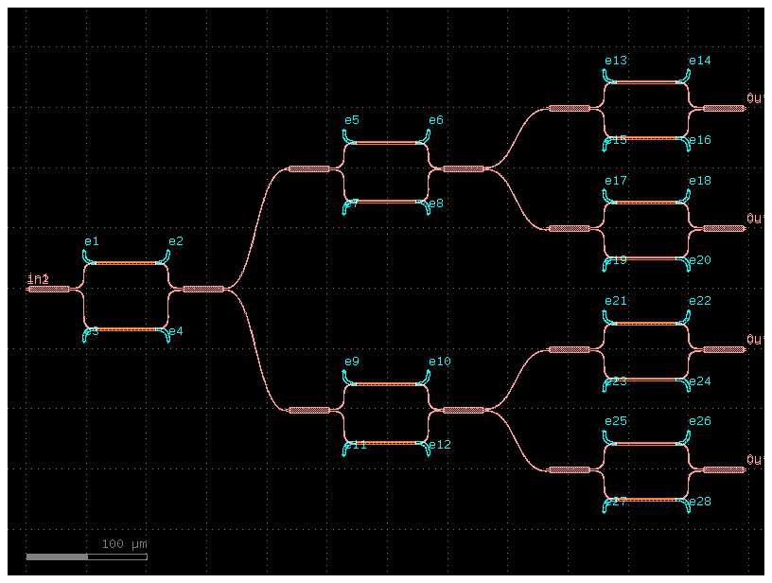

Layout:

Slide 20
Conclusions:
This work allowed us to see how each stage in WDM design is important, since the number and configuration of these stages directly determine the number of wavelengths that can be multiplexed or demultiplexed.
Likewise, phase-shifter filters play a fundamental role, as they allow for the proper selection and filtering of wavelengths. This enables the efficient use of power division in the Mach-Zehnder interferometer (MZI), at both the upper and lower outputs. Furthermore, in a real-world manufacturing scenario, these elements offer the possibility of calibrating the device to compensate for deviations or imperfections introduced during the manufacturing process.

Slide 21

Gracias

